Slide 1
Understanding Errors

Slide 2
What is an error?
A problem or exception that occurs during the execution of a program.
Prevents the program from functioning correctly.
Remains undetected until the program is compiled or run.

Slide 3
Types of Errors
Errors
Syntax
Errors
Logical
Errors
Runtime
Errors

Slide 4
Syntax Errors
Occurs when the code violates the rules of the Java programming language's syntax.
Also known as compile-time error.
Consequence: The program cannot be successfully compiled and needs to be fixed before it can be executed.
Easy to identify because the Compiler explicitly mentions the error when compiling the code.

Slide 5
Syntax Errors (Continued)
class HelloWorld {
public static void main (String[] args) {
System.out.println("Hello, World!";
}
}
1 error found:
File:C:\Users\Desktop\SyntaxError.java[line:3]
Error: ')' expected

Slide 6
Syntax Errors (Continued)
class SyntaxError {
public static void main (String[] args) {
int x = 10
}
}
1 error found:
File:C:\Users\Desktop\SyntaxError.java[line:3]
Error: ';' expected

Slide 7
Syntax Errors (Continued)
class SyntaxErrorExample2 {
public static void main (String[] args) {
System.out.println(value);
}
}
1 error found:
File:C:\Users\Desktop\SyntaxErrorExample2.java[line:3]
Error: cannot find symbol
symbol: variable value
location: class SyntaxErrorExample2

Slide 8
Logical Error
Refers to a mistake in the program's logic that leads to incorrect results.
Can’t detect during runtime or compile time.
Hardest to identify.

Slide 9
Logical Errors (Continued)
class LogicalError {
public static void main (String[] args) {
int num1 = 10, num2 = 20;
System.out.println("Summation = " + (num1-num2));
}
}
Welcome to DrJava. Working directory is C:\Users\Desktop
> run LogicalError
Summation = -10
This program won’t show any error but it is logically incorrect because the output should be 30.

Slide 10
Runtime Errors
Errors that occur while running the program.
Not caught during Compilation time.
Quite common type of errors but easily traceable.
N.B. You’ll learn more about Exceptions in the later courses.

Slide 11
Runtime Errors (Continued)
class RuntimeError {
public static void main (String[] args) {
int num1 = 10;
System.out.println("Division = " + (num1/0) );
}
}
Welcome to DrJava. Working directory is /home/iqra/Documents
> run RuntimeError
java.lang.ArithmeticException: / by zero
This program won’t know there’s an error while compiling but when it tries to execute it’ll realize that an integer is being divided by 0 and will throw ArithmeticException.

Slide 12
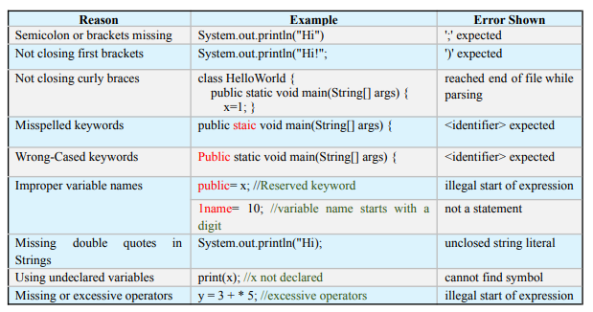
Examples of Syntax Error

Slide 13
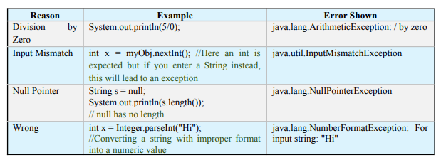
Examples of Runtime Error

Slide 14
THANK YOU!

